Slide 1


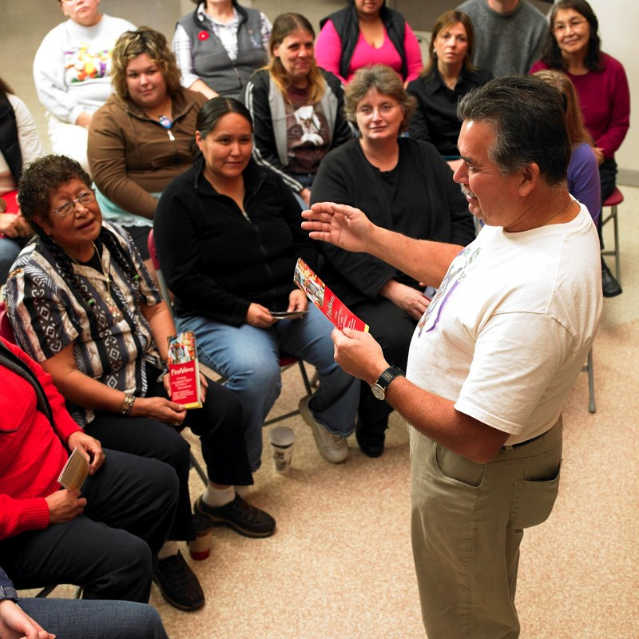
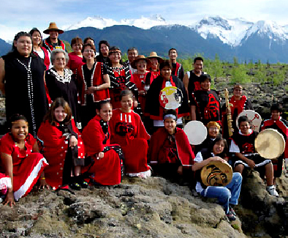
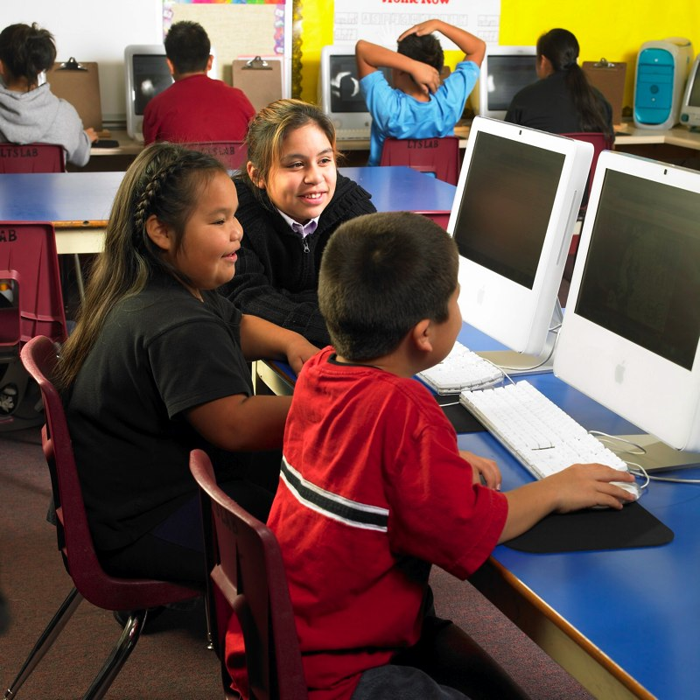
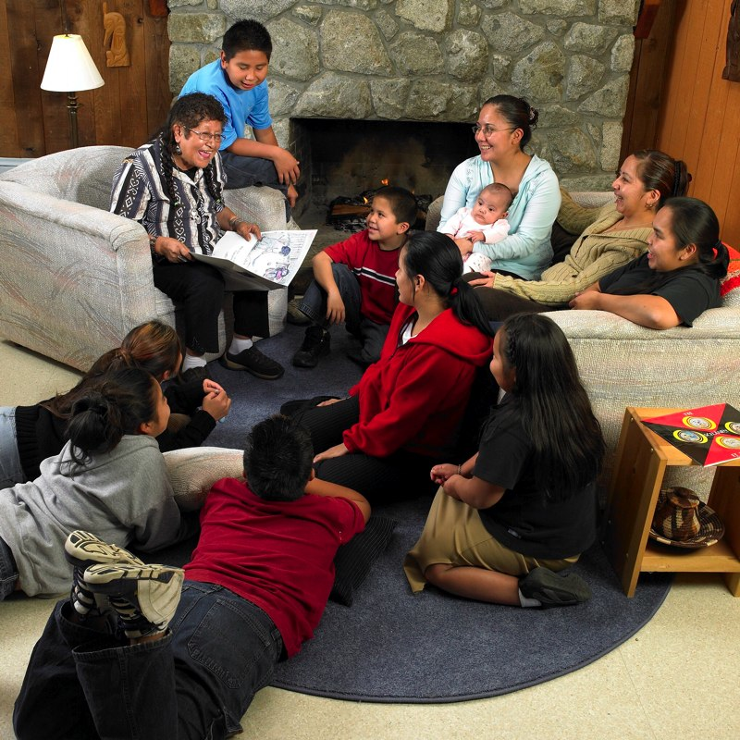

First Peoples’ Cultural Council Arts Programs
Cathi Charles Wherry, Arts Programs Manager

Slide 2
First Peoples’ Cultural Council
Established in 1990
Legislation - First Peoples’ Heritage, Language and Culture Act
Mandate to support the vitality of B.C.’s First Nations Languages, Arts, Cultures and Heritage
Activities:
Funding for Arts, Language & FirstVoices programs
Resource and materials development
Training and support
Strategic Initiatives
Advocacy for First Nations languages, arts and cultures
Notes:
FPCC is unique in Canada
Our legislation supports the creation of the organization and provides us with a mandate
We are the delivery agent for funding for arts, language and FirstVoices
Resource and materials development –
A Guide to Language Policy and Planning for B.C. First Nations Communities
B.C.’s Master-Apprentice Language Program
Artist Grant Proposal Writing Handbook
Advocacy: write papers and publish reports - Report on the Status of BC First Nations Languages

Slide 3
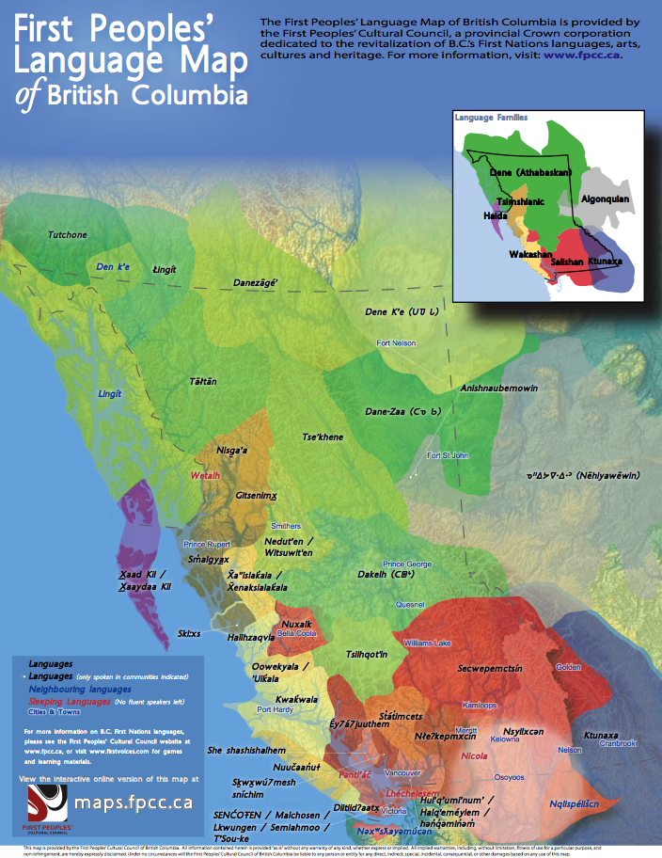
Who Our Programs Serve
203 BC First Nations communities
34 B.C. Indigenous languages
B.C. First Nations communities and Individuals
Aboriginal and Metis living in urban areas
Aboriginal artists and arts organizations and collectives

Slide 4
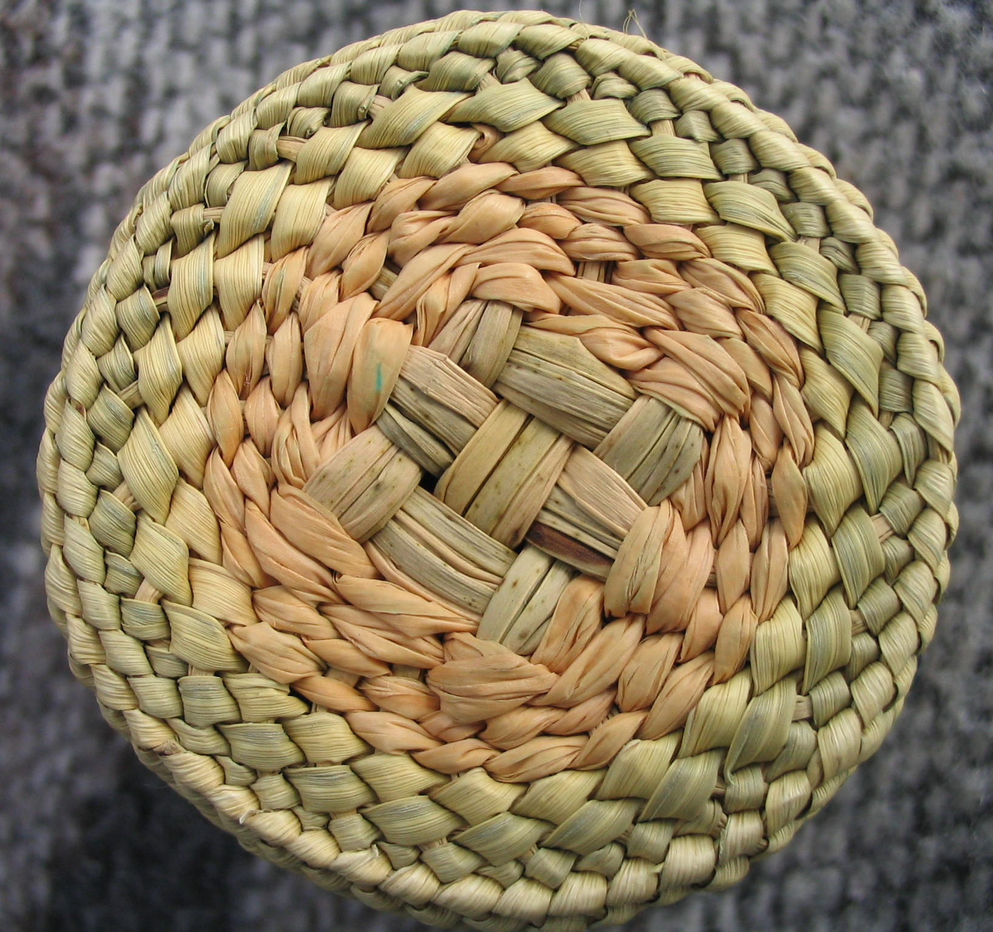
Five Arts Grant Programs Application Deadline – October 31, 2016
Applications accepted from
Individuals,
Organizations, Collectives, First Nation Communities
All Artistic Disciplines
visual, music, storytelling, dance, performing arts
All approaches
Traditionally based and Experimental
Notes:
Very general – who can apply, what kind of projects are supported

Slide 5
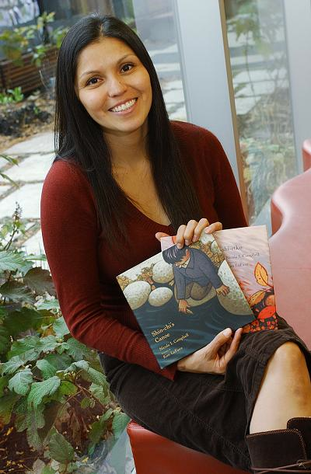
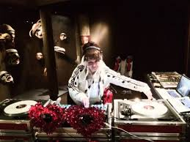
Individual Emerging Artists
Grants to individual artists
Up to $5000
Projects that assist with artistic and creative development or moving forward in some way
Notes:
Aboriginal Arts Development Awards:
103 applications – 52 funded - $555,000 for all programs in 2012/13
Grants to individual artists – up to $5,000
Organizations and collectives – up to $25,000
Sharing traditional arts - $12,000
Arts Administrator - $30,000 – going to a full-time wage
and to organizations and groups working in all disciplines, using both very traditional and experimental approaches.

Slide 6
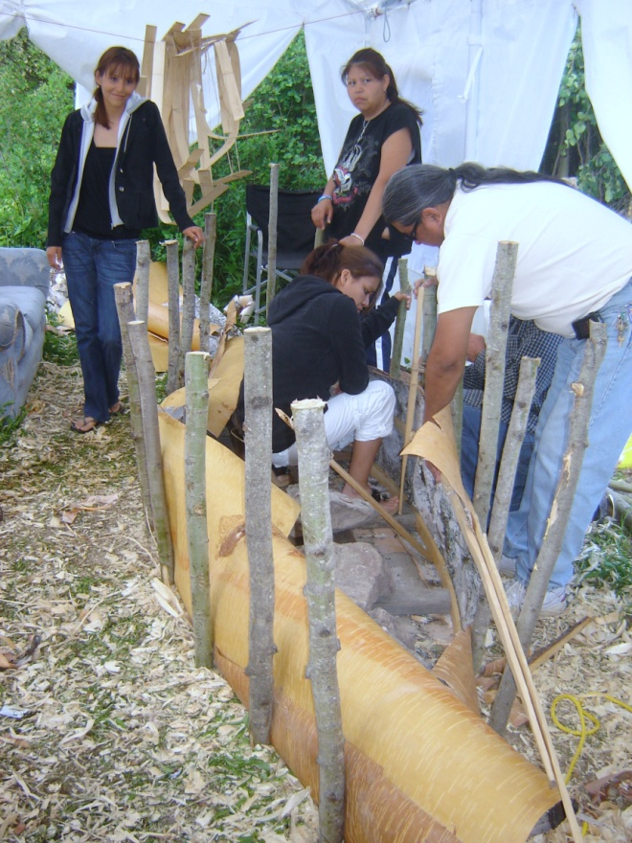
Sharing Traditional Arts Across Generations
Grants to organizations, groups and collectives, or First Nation communities
Up to $12,000
Projects that are focused on the transmission of traditional arts skills and knowledge

Slide 7
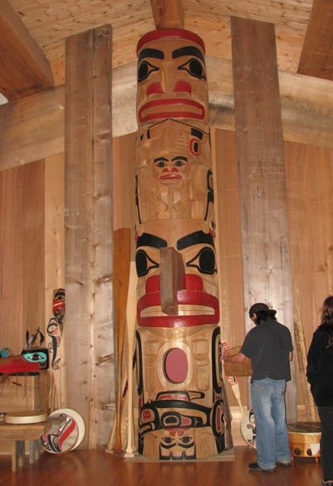
Organizations and Collectives
Grants to organizations, groups or collectives, or First Nation communities
Up to $15,000 for projects, production, workshops and other activities
and
Up to $15,000 for organizational capacity development

Slide 8
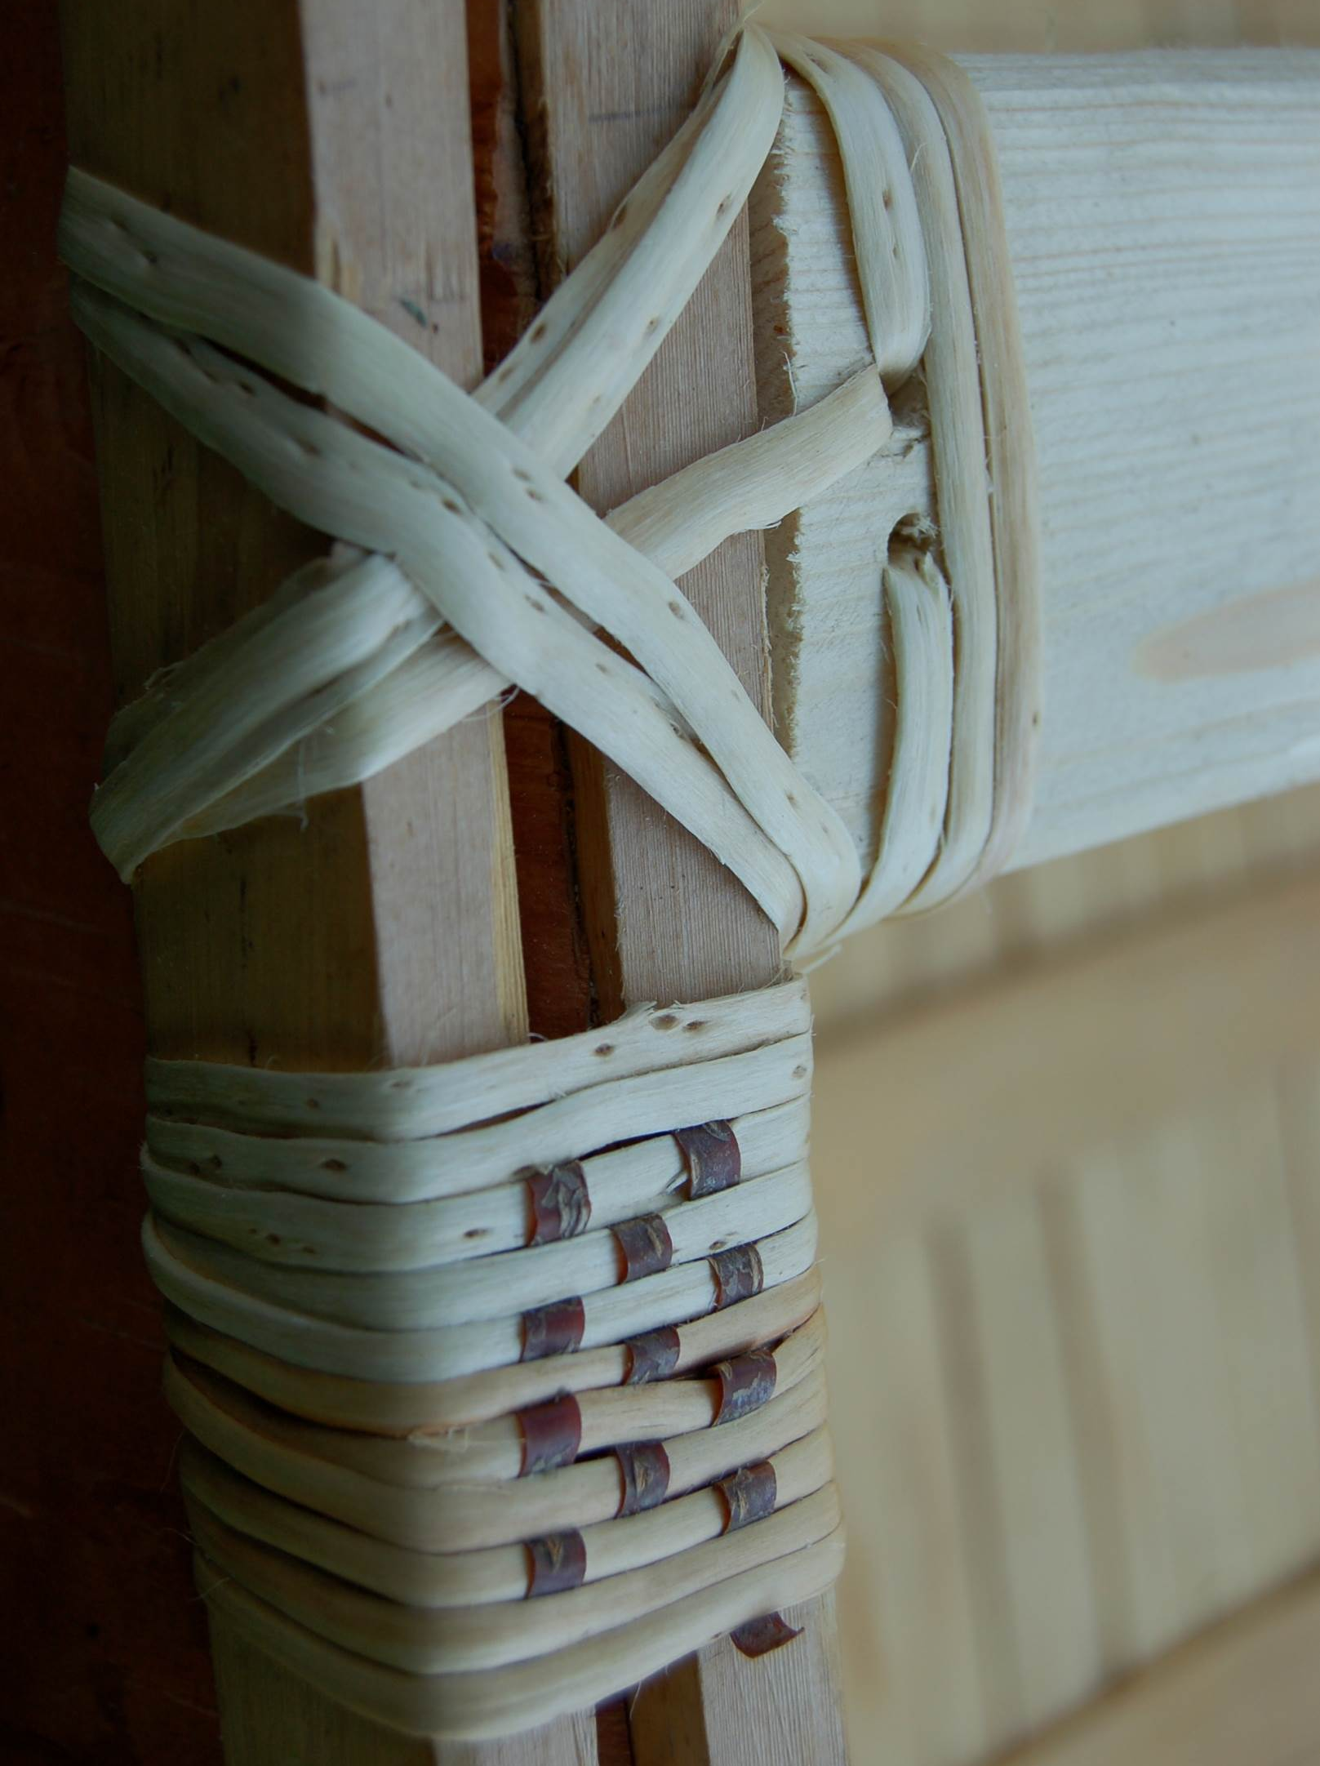
Arts Administrator Internships
Internships jointly proposed by the intern and the host organization
Up to $30,000 for one year
Internships focused on arts administration, cultural management, curatorial practice

Slide 9
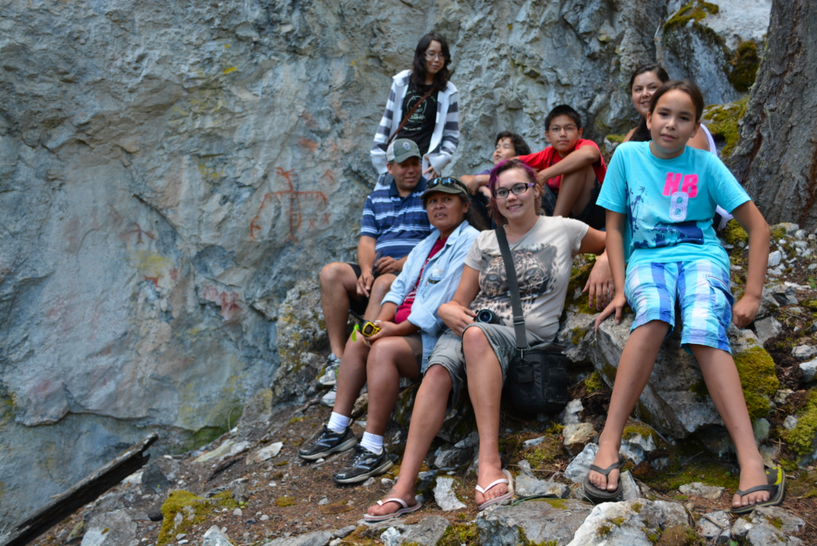
Aboriginal Youth Engaged in the Arts
Grants to organizations, groups and collectives, or First Nation communities
Up to $13,000
Projects that engage groups of youth in the arts through mentorship and workshops

Slide 10
Five Grant Programs
Total of $877,000 awarded to 77 projects last year
Aboriginal Arts Development Awards
Sharing Traditional Arts Across Generations - $12,000
Organizations and Collectives - $30,000
Arts Administrator and Cultural Manager Internships - $30,000
Individual Emerging Artists - $5000
Aboriginal Youth Engaged in the Arts - $13,000
Next Deadline: October 31, 2016
Notes:
Aboriginal Arts Development Awards:
103 applications – 52 funded - $555,000 for all programs in 2012/13
Grants to individual artists – up to $5,000
Organizations and collectives – up to $25,000
Sharing traditional arts - $12,000
Arts Administrator - $30,000 – going to a full-time wage
and to organizations and groups working in all disciplines, using both very traditional and experimental approaches.

Slide 11
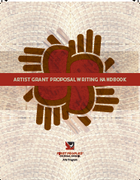
Community Development Approach
Accessible Materials
Supportive Delivery Process /
Applicant Technical Support
Adjudication committees
Constructive Follow-up
Notes:
Peer review, fair representation, builds capacity for those artist and that goes back to the communities, learn about proposal writing, learn from each other

Slide 12
Contact Information
First Peoples’ Cultural Council
250-652-5952
www.fpcc.ca
Arts Program Staff
Cathi Charles Wherry, Arts Program Manager
cathi@fpcc.ca
Kyla Schorneck, Arts Program Assistant
kyla@fpcc.ca
Janice Webster, Arts Administrative Assistant
janice@fpcc.ca

